Slide 1
OPTIMAL AMBULANCE POSITIONING FOR ROAD ACCIDENTS USING DEEP LEARNING
Presented by:-
SHIVAM SHARMA,23BCE11292
GOKUL SANTHOSH,23BCE11291
ALLEN MATHEWS,23BCE11302

Slide 2
1
ABSTRACT
Problem: High number of casualties and fatalities from road accidents. Solution: Pre-positioning ambulances to reduce response time.
Approach: Deep-embedded clustering-based approach to predict optimal ambulance locations. Key factors: Geographical region factors and patterns for predicting accident hotspots.
Model building: using k-means algorithm
Comparison: Comparison with traditional clustering algorithms (K-means, GMM, Agglomerative). Evaluation: Novel scoring function for real-time response time and distance calculation.
Results: High accuracy (95%) and better performance compared to traditional algorithms.

Slide 3
3
INTRODUCTION
Road accidents pose critical challenges to emergency response systems. Swift ambulance deployment is essential to reduce casualties.
This project focuses on "Optimal Ambulance Positioning for Road Accidents with Deep Embedded Clustering."
It aims to revolutionize emergency services by using advanced data analytics and machine learning.
Deep embedded clusteringwill be used to optimize ambulance positioning based on:
Historical accident data
Traffic dynamics
Accident severity
The goal is to enhance the efficiency and effectiveness of emergency response. Ultimately, it seeks to improve outcomes for accident victims.

Slide 4
PROBLEMS
Delayed Response Times: Ambulances take longer to reach accident sites, increasing the risk of fatalities. Increased Casualties: Slow response reduces the chance of survival for critically injured victims.
Inefficient Resource Allocation: Ambulances may be deployed to less critical areas, leaving high-risk areas underserved.
Traffic Congestion Impact: Ambulances get stuck in traffic, further delaying medical assistance. Unpredictable Response: Ambulances are dispatched reactively, leading to inconsistent and unreliable emergency services.
Higher Operational Costs: Increased fuel consumption and staff time due to longer travel distance to accident
scenes.

Slide 5
OBJECTIVE
1. Data Collection and Preprocessing: Gather comprehensive historical data on road accidents, including locations, times, severity, and other contextual factors. We will also collect data on existing ambulance locations, traffic patterns, and demographic information.
2. Deep Embedded Clustering Methodology: Develop and implement advanced clustering algorithms using deep learning techniques to identify optimal locations for ambulance deployment. This will involve transforming raw data into meaningful representations that can highlight high-risk accident hotspots.
3. Response Time Simulation: Create a simulation model to evaluate the efficiency of different ambulance positioning strategies based on clustering results. This model will analyze response times across various scenarios, considering urban layouts, traffic conditions, and time-of-day variations.

Slide 6
4. Real-time Data Integration: Integrate real-time data feeds, such as traffic conditions, weather, and current ambulance allocations, to update and refine clustering dynamically. This will ensure the optimization strategy remains relevant and effective in real-world situations.
5. System Validation and Testing: Validate the proposed system through a series of case studies and simulations. We will compare the performance of our model against existing ambulance positioning strategies to measure improvements in response times and service efficiency.

Slide 7
STUDY AREA AND MATERIALS
Focus on optimal ambulance positioning using real-time crash data from Nairobi.
Additional datasets include road and weather conditions at crash locations.
Problem framed as a clustering task to find optimal ambulance positions. Aims to identify city-wide risk patterns and accident-contributing factors.
Analysis explores relationships between attributes in the datasets to uncover patterns and correlations.
Machine learning and clustering techniques applied for data analysis.
Factors like accident frequency and geographical conditions guide model development.
Goal: Suggest strategic ambulance placement for improved emergency response efficiency in Nairobi.

Slide 8
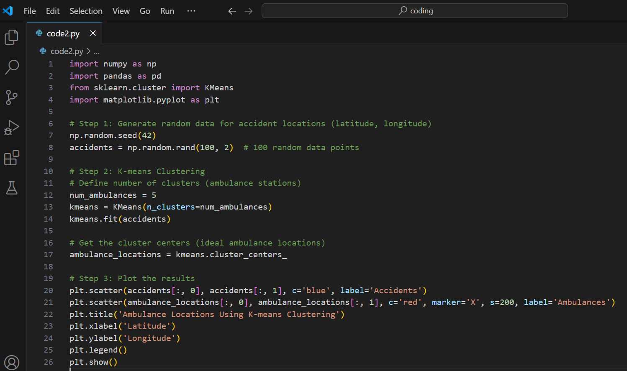
code

Slide 9

METHODOLOGY&explaination
Data Collection / Simulation
Input Data: In real-world applications, data might come from historical accident records, population density, or emergency calls. Each data point represents the location (e.g., latitude and longitude) of an event where an ambulance may be needed.
Simulated Data: For demonstration purposes, we generate random 2D data points to represent accident locations. In practice, this would be replaced with actual accident or emergency data.
The Accidents Array contains 100 points each with a latitude and longitude.

Slide 10

Clustering With K-means
K-Means Algorithm: K-means is an unsupervised learning algorithm that partitions the data into K clusters by minimizing the variance within each cluster. The centroids of these clusters represent the optimal locations where ambulances can be stationed.
We define the number of clusters (num_ambulances) as the number of ambulances we want to deploy. K-means is then applied to the accident data to find num_ambulances cluster centers.

Slide 11

Centroids: The centroids of the clusters are the optimal positions for ambulance placement, as these are the points that minimize the average distance to the nearest accident location within each cluster.

Slide 12
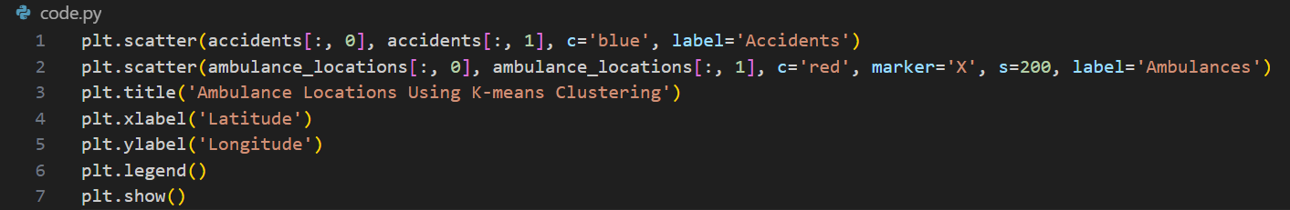
visualisation
Plotting Accident Data: We plot the accident locations (blue dots) and ambulance stations (red Xs) on a 2D plane.
This visualization helps understand how well the ambulance locations are distributed relative to the accidents, giving a spatial sense of coverage.

Slide 13
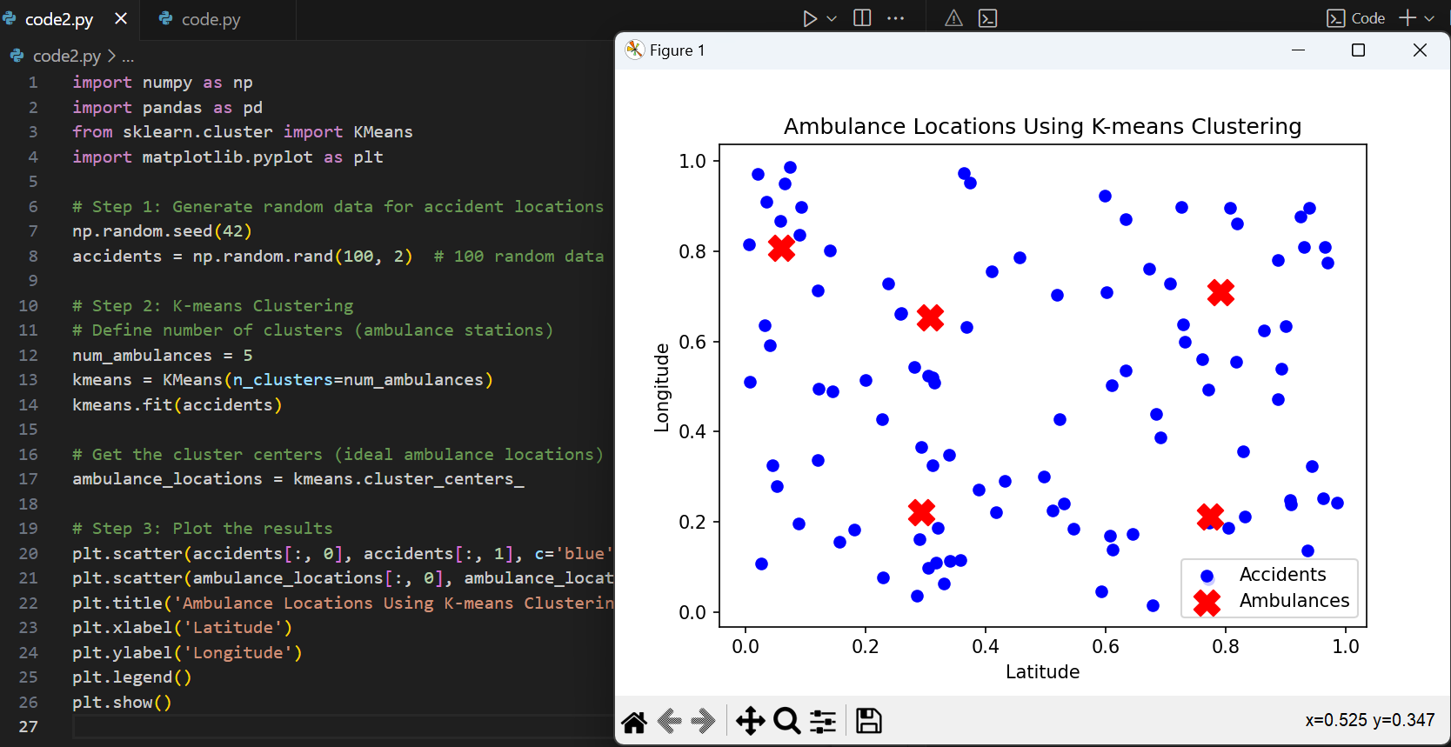
RESULT

Slide 14
Gaussian Mixture Model (GMM)
How it works: GMM assumes that data points are generated from a mixture of several Gaussian distributions. Instead of assigning each point to a single cluster, it provides probabilities for belonging to multiple clusters.
Strengths:
Handles overlapping clusters better than K-Means.
Accommodates clusters of varying shapes and densities.
Use Case: If your data might contain clusters that are not spherical or have significant overlap, GMM can perform better than K-Means.

Slide 15
K-Means Limitation Solved:
Fixed Cluster Shapes: K-Means assumes spherical clusters with equal variance, which limits its effectiveness with complex or overlapping clusters.
Hard Assignments: K-Means assigns each point to a single cluster rigidly, while GMM uses probabilities, allowing for soft assignments.
Why GMM is Better:
Models clusters with varying shapes, sizes, and densities using Gaussian distributions.
Handles overlapping clusters and provides probabilistic interpretations of cluster membership.
When to Prefer GMM:
If your data contains non-spherical clusters or overlaps, GMM typically performs better than K-Means.

Slide 16
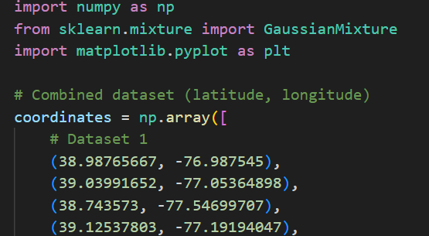
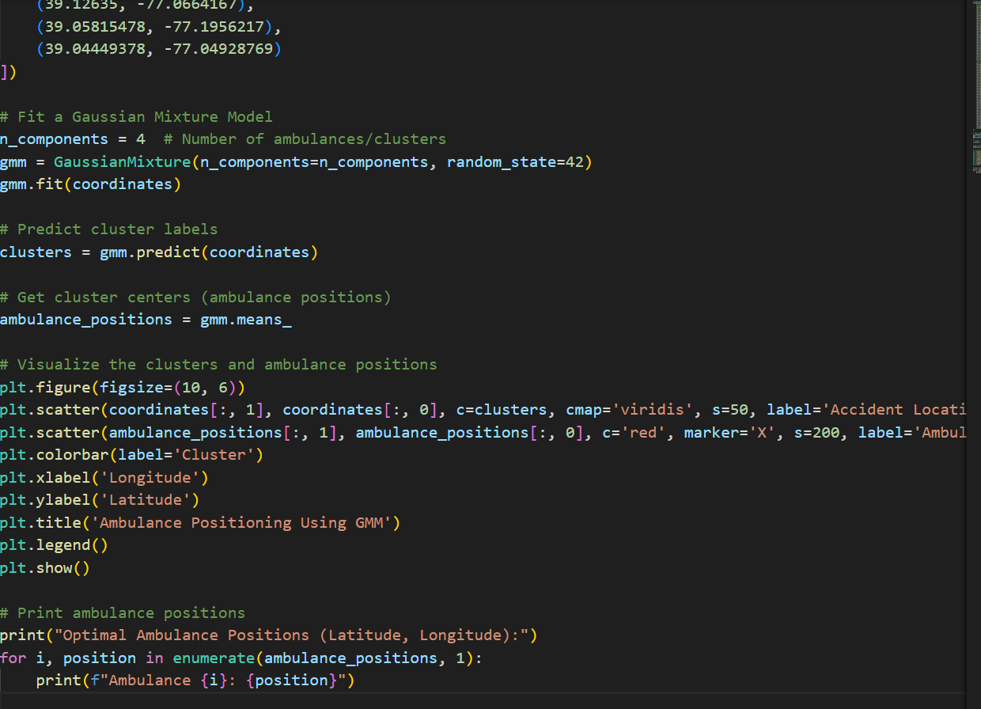
code

Slide 17
n_components=4: Indicates the number of clusters or groups to create. Each cluster corresponds to one ambulance position.
random_state=42: Ensures reproducibility by setting a fixed seed for random number generation.
.fit(coordinates): Fits the GMM to the accident locations to find natural groupings (clusters).
.predict() assigns each location to one of the clusters identified by the GMM.
gmm.means_: Gives the coordinates (latitude, longitude) of the cluster centers.
cmap='viridis': Specifies the color map (viridis) to use for cluster coloring.
s=50: Sets the size of each point in the scatter plot.
Plt.show renders the plot on the screen

Slide 18
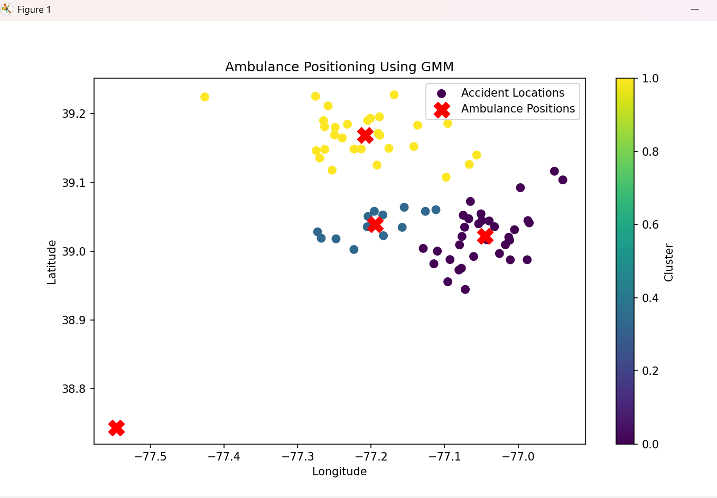
RESULT

Slide 19
DBSCAN (Density-Based Spatial Clustering of Applications with Noise)
How it works: Groups points that are closely packed together while marking outliers as noise based on a distance threshold and minimum points in a cluster.
Strengths:
Does not require predefining the number of clusters.
Effective for non-spherical clusters and datasets with noise.
Use Case: If your data contains noise or irregularly shaped clusters, DBSCAN can be a strong alternative to K-Means.

Slide 20
K-Means Limitation Solved:
Predefined Number of Clusters: K-Means requires the user to specify the number of clusters (k) in advance, which is not always practical.
Sensitivity to Outliers: K-Means is highly sensitive to noise and outliers, which can skew the cluster centroids.
Why DBSCAN is Better:
Does not require the number of clusters as input.
Automatically identifies outliers and treats them as noise.
Effectively clusters data with irregular shapes or density variations.
When to Prefer DBSCAN:
If your data contains noise or irregularly shaped clusters, DBSCAN provides a more robust alternative.

Slide 21
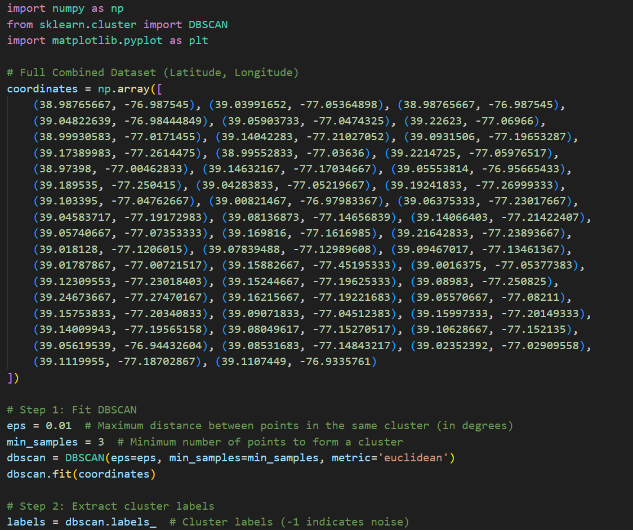
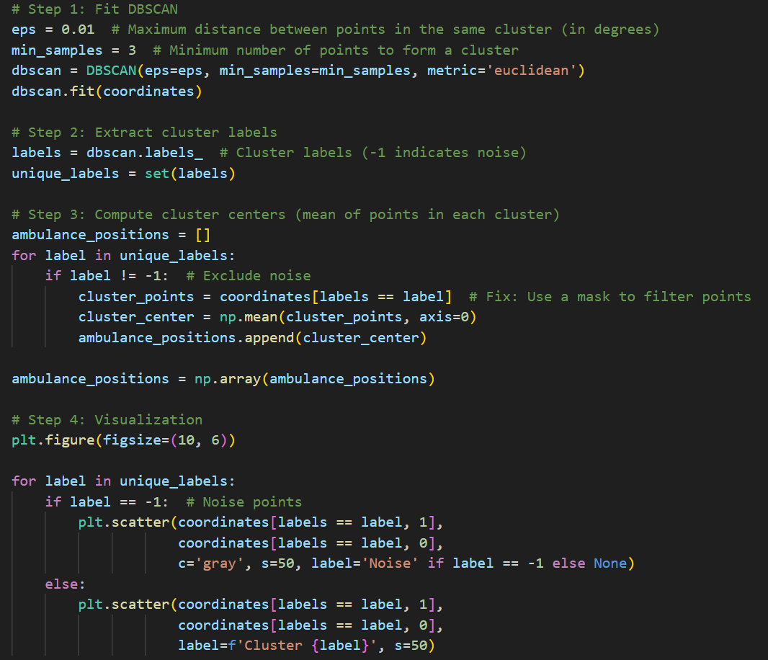
CODE

Slide 22
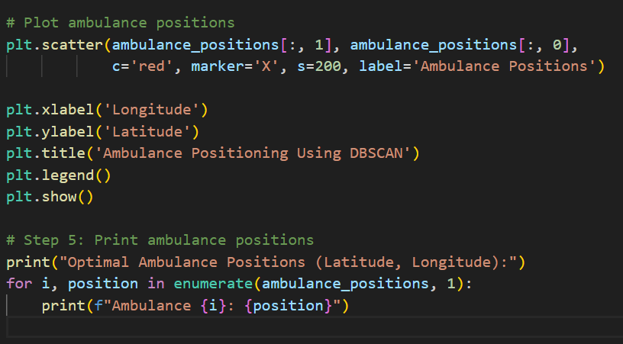

Slide 23
eps: The maximum distance between two points for them to be considered in the same cluster. A smaller value results in smaller clusters.
min_samples: The minimum number of points required to form a cluster.
metric='euclidean': The distance metric used to measure proximity (Euclidean distance between points).

Slide 24
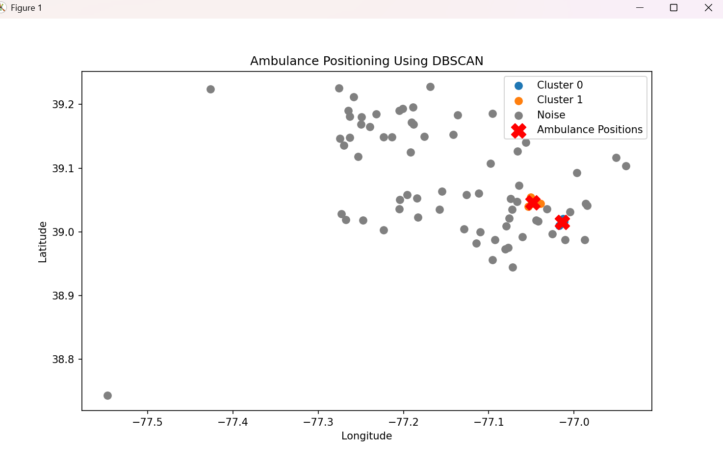
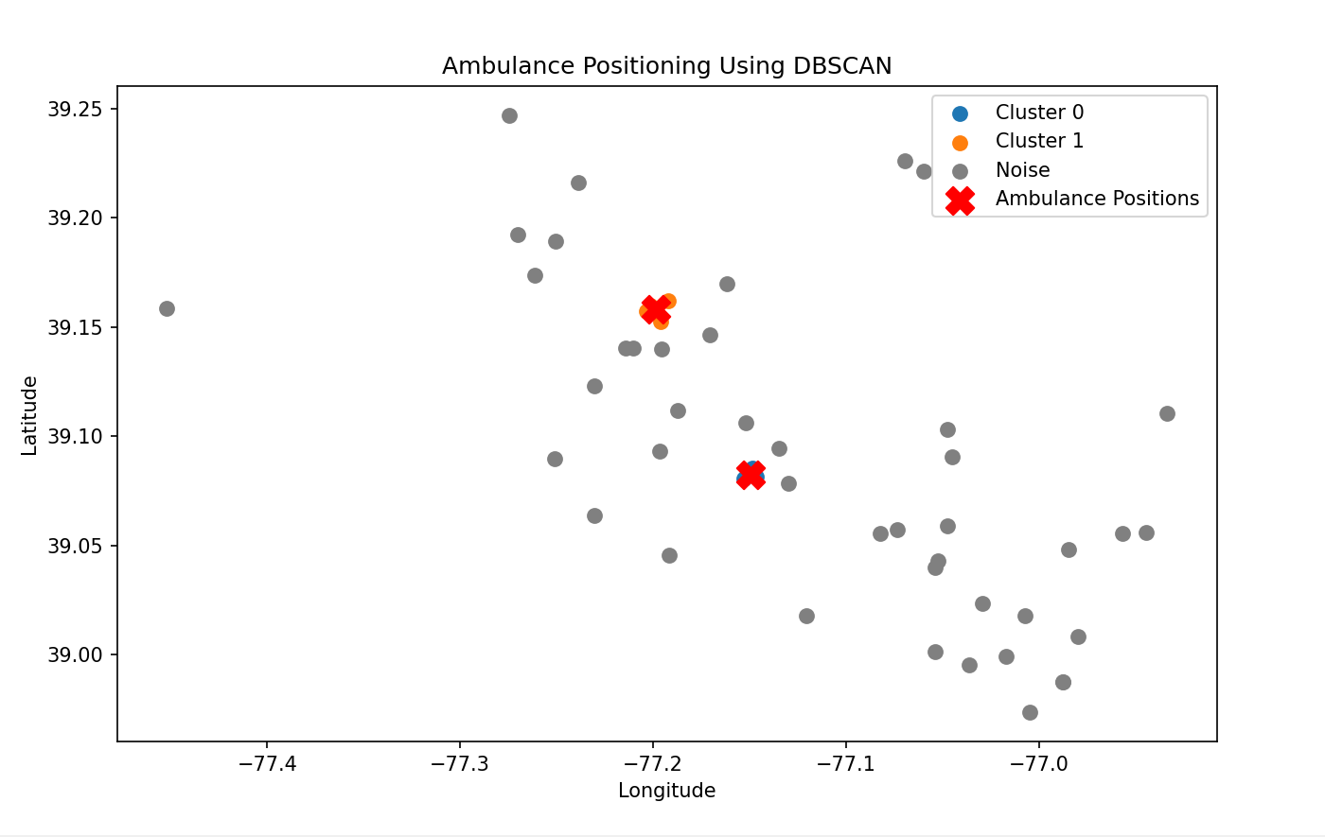
result

Slide 25
These methods address some of K-Means’ limitations, such as the assumption of spherical clusters and sensitivity to initialization and noise. Using them provides a broader comparison of clustering effectiveness.

Slide 26
Mean shift clustering
Advantages of Mean Shift Clustering
Adaptive Number of Clusters:
Unlike K-Means, GMM, and AHC, Mean Shift does not require you to specify the number of clusters in advance. It automatically finds the number of clusters based on the data distribution.
Identifies Dense Regions:
Mean Shift works by iteratively shifting points toward regions of higher density. This makes it excellent for locating optimal positions for ambulances in areas with high accident frequency.
Robust to Outliers:
Mean Shift focuses on dense regions, so outliers or sparsely located accidents have minimal impact on the final cluster centers.
No Assumptions About Cluster Shape:
Unlike K-Means (which assumes spherical clusters) and GMM (which assumes Gaussian distributions), Mean Shift can handle arbitrarily shaped clusters.
Real Data Points as Centers:
Cluster centers found by Mean Shift correspond to dense regions, making them practical for positioning ambulances close to real accident locations.

Slide 27
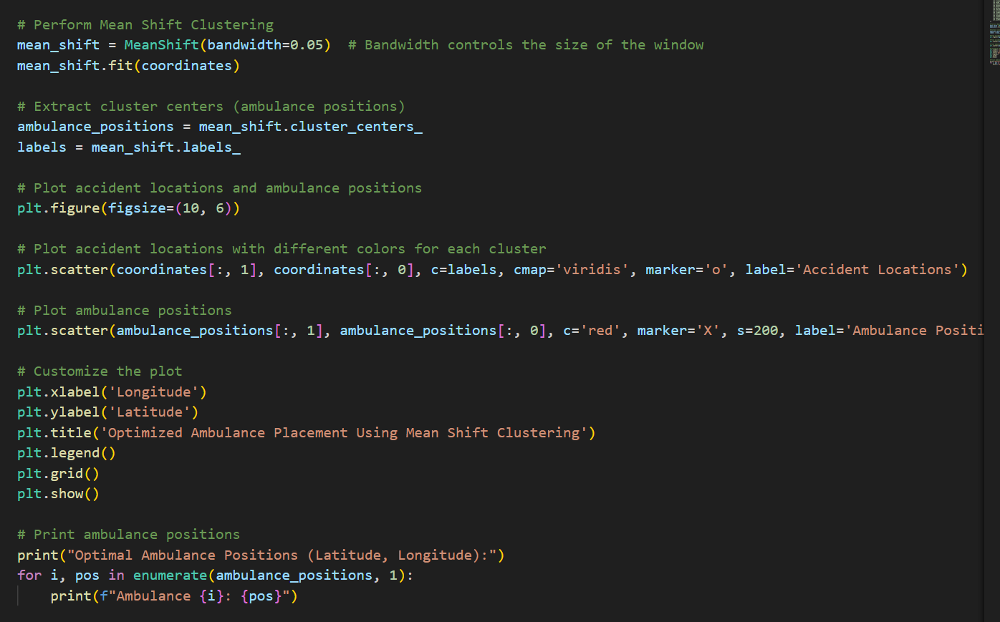

Slide 28
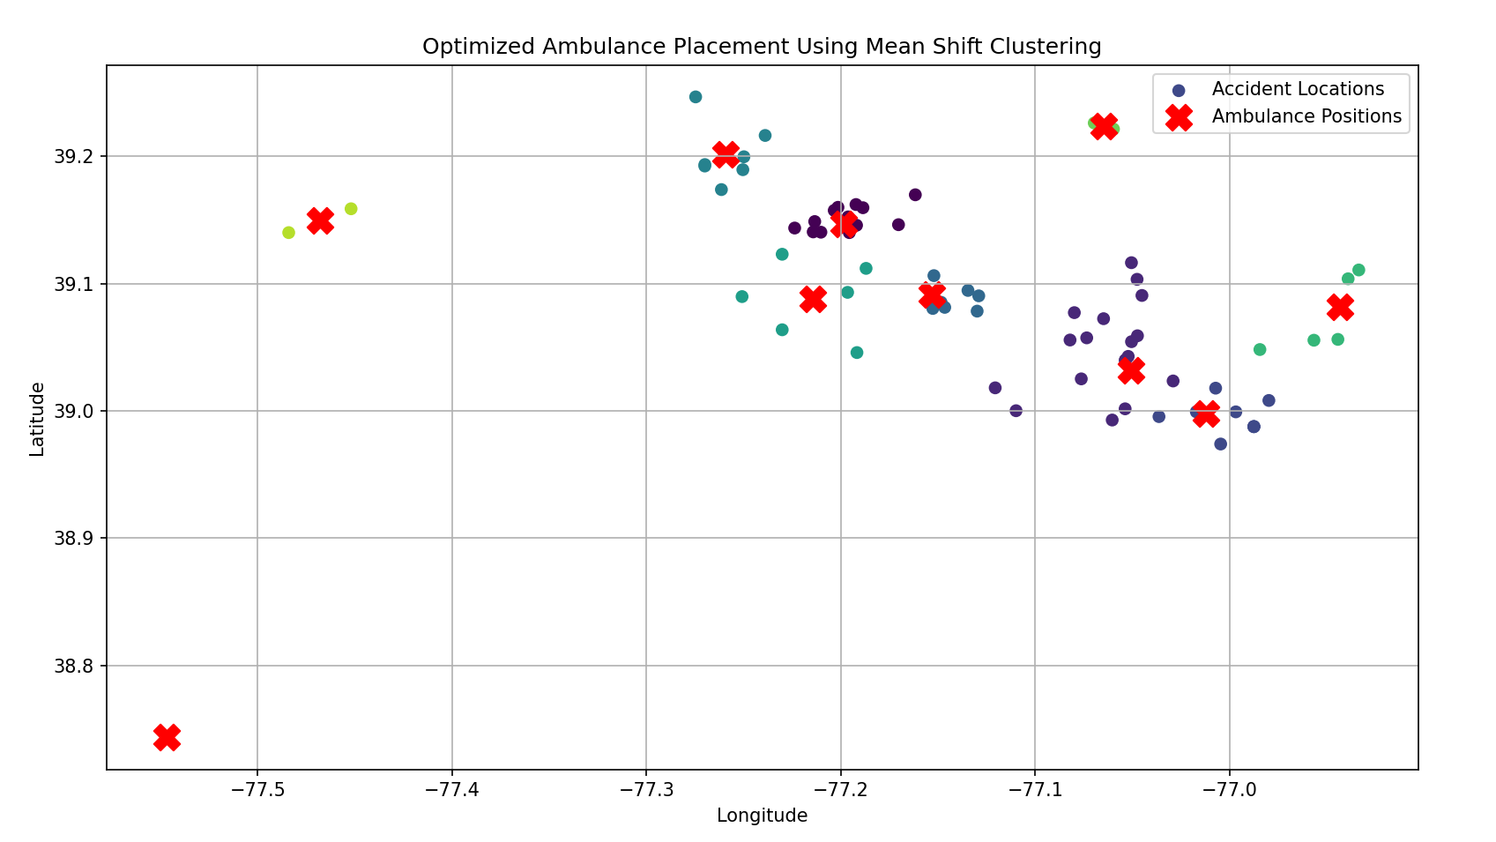
RESULT

Slide 29
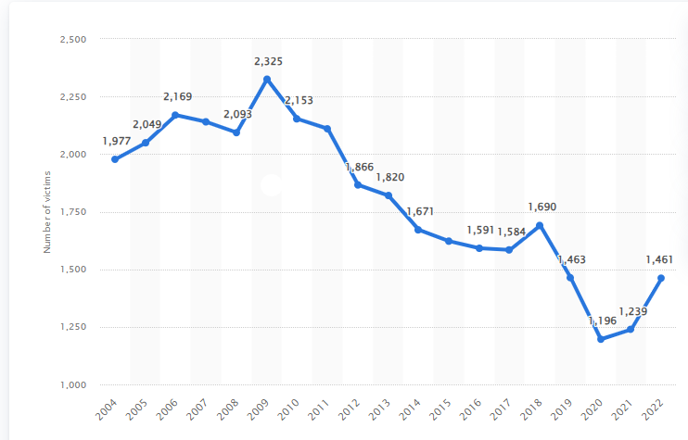
Road Accident Statistics In Delhi, From 2004 to 2022

Slide 30
Key Observations:
Steady Increase (2004-2009): There was a rise in road accident victims from 2004 to 2009, peaking in 2009 with 2,325 victims.
Decline (2009-2020): After 2009, the numbers generally show a downward trend. By 2020, the number of victims reached its lowest, with 1,196 victims.
Slight Increase (2021-2022): There was an increase from 1,239 victims in 2021 to 1,461 in 2022.
Factors That Could Influence These Trends:
Increased urbanization and traffic density.
Improved road safety measures and stricter traffic regulations.
COVID-19 lockdowns .
Resumption of normal activities after the pandemic.

Slide 31
Data Collection
---------------------------- Accident data Real-time traffic Road & weather GPS from ambulances
Pre processing & Feature Extraction
Accident Hotspot Prediction (CNN/LSTM)
Ambulance Hotspot Strategy
Feedback Loop
Ambulance Dispatch
Real-Time Route Optimization (GNN)
Cluster Hotspots (K-means/DBSCAN)

Slide 32
FUTURE SCOPE
Advanced Analytics
Real-Time Tracking:
AI and Machine Learning
Smart City Integration
Community Engagement
Telemedicine Support
Collaboration with Other Services
Geospatial Analysis
Training and Simulation.
Regulatory Updates

Slide 33
CONCLUSION
Data and AI
Real-time Tracking
Predictive Models
Smart City Integration
Community Input:
Telemedicine.
Collaboration
Mapping Tools
Training
Updated Policies

Slide 34
THANK YOU

